Slide 1
Convolutional Neural Networks June 12, 2020
Applied Data Science
MMCi Term 4, 2020
Matthew Engelhard
Many slides created by Tim Dunn
Notes:
Open up the black box as best we can.

Slide 2
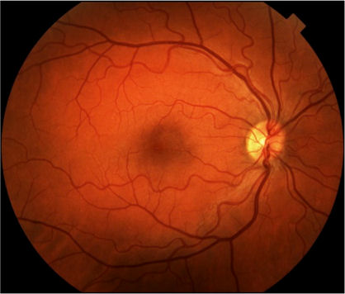
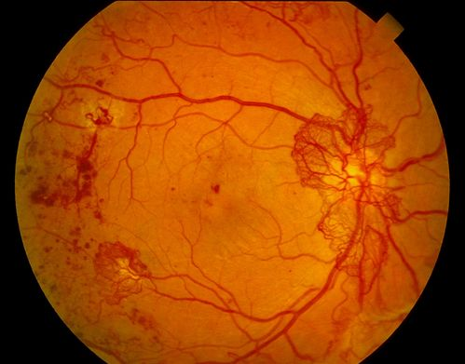

Deep Learning for Image Analysis
Diabetic Retinopathy Classification
Healthy Retina
Unhealthy Retina

Slide 3
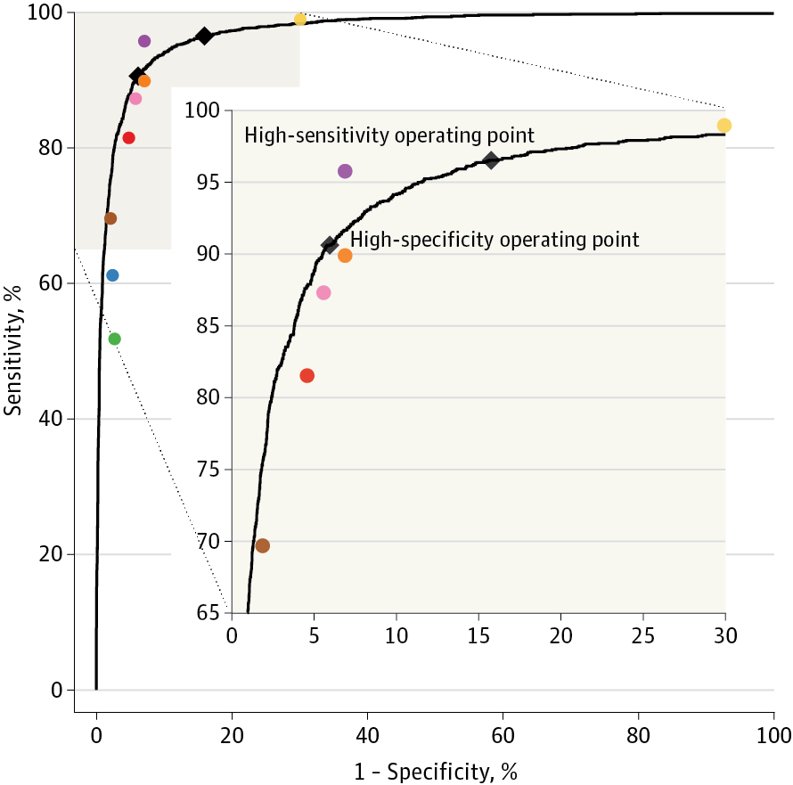
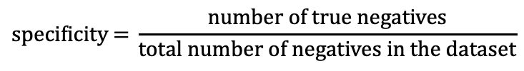
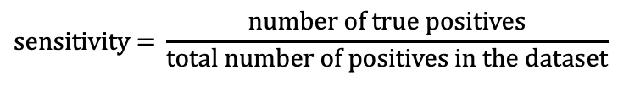
Deep Learning for Diabetic Retinopathy Classification
$$\text{sensitivity}\text{ = }\frac{\text{number} \text{of} \text{true} \text{positives}}{\text{total} \text{number} \text{of} \text{positives} \text{in} \text{the} \text{dataset}}$$
$$\text{specificity}\text{ = }\frac{\text{number} \text{of} \text{true} \text{negatives}}{\text{total} \text{number} \text{of} \text{negatives} \text{in} \text{the} \text{dataset}}$$
Gulshan et al. JAMA (2016)
Notes:
Talk thru sensitivity and specificity . Add that this is an advertisement for Matt. Add 2x2 table…maybe show moving a threshold. Add equation. Say that with sensitivity, “the higher the better”, and with 1- Specificity, also higher is better, but here is 1- specificity, so lower is better. Start with a different graph to explain. Animate so that after I state, superimpose human performance, add human points. Keep the message simple. The CNN is doing better than 80% of the physicians. Animate the inset

Slide 4
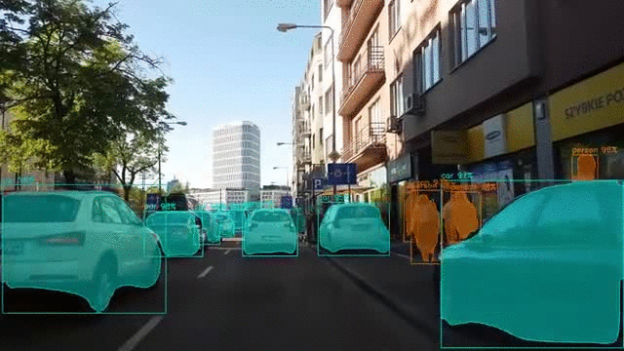
Mask R-CNN
Notes:
Point out that here, we have multiple objects recognized as distinct even though they share a label

Slide 5
Motivating the CNN: Back to MNIST
Zeros
Ones

Slide 6
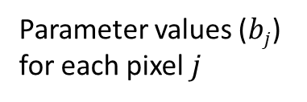
A “Filter” to Detect Ones
Parameter values ($bj$)
for each pixel $j$

Slide 7
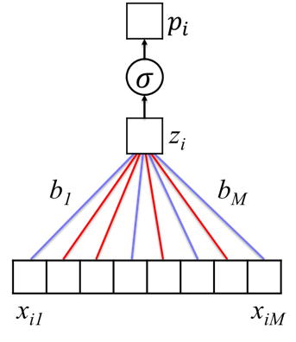
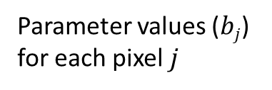
A “Filter” to Detect Ones
VECTORIZE
Parameter values ($bj$)
for each pixel $j$

Slide 8
A “Filter” to Detect Ones
Positive Section

Slide 9

A “Filter” to Detect Ones
Positive Section
$$σ\left( \right)=.991$$

Slide 10
What if we’d like to find a 1 anywhere in a larger image?
Notes:
This approach works well if digits are at the center of a small image
What if we’d like to determine if a 1 is present anywhere within a larger image?

Slide 11
Searching for a 1…

Slide 12
Searching for a 1…

Slide 13
Searching for a 1…

Slide 14
Our previous approach looks for a 1 at a specific location.
MLP Classifier

Slide 15
Our previous approach looks for a 1 at a specific location.
“1”
MLP Classifier

Slide 16
If we move the position of the 1, it no longer works.
?
MLP Classifier

Slide 17
Instead of using logistic regression or an MLP, let’s look for a new kind of model, one with more flexible filters
“1”
New Classifier
Notes:
Note that the key idea here is actually to think of this process as a filter.
Very natural to feed pixels into a logistic regression model.
Only by thinking of this as a filter do we think to move it.

Slide 18
Instead of a filter that’s the size of the whole image, we’d like a smaller filter that we can move around

Slide 19
As we move this filter, we calculate the inner product between the filter itself and the portion of the image that’s underneath it.

Slide 20
When the filter is placed over a region that looks like the filter, the inner product (i.e. filter output) will be large.

Slide 21
When it’s placed over a region that does not look like the filter, the inner product (i.e. filter output) will be small

Slide 22
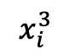
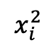
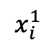

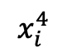
Examining filter output $σ(x_{i}^{R}⊙b)$, where $x_{i}^{R}$ is the portion of image $i$ where the filter is placed.
$$x_{i}^{1}$$
$$x_{i}^{2}$$
$$x_{i}^{3}$$
$$x_{i}^{4}$$

Slide 23
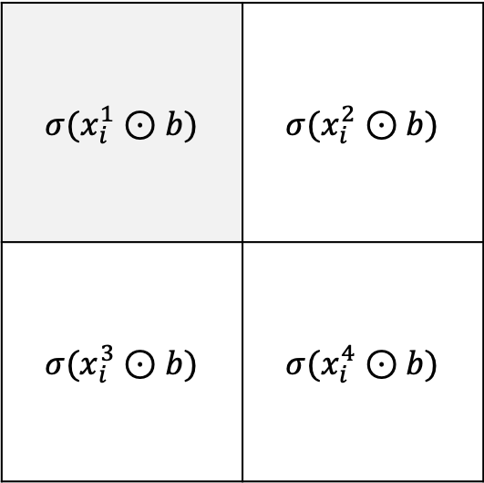
Examining filter output $σ(x_{i}^{R}⊙b)$, where $x_{i}^{R}$ is the portion of image $i$ where the filter is placed.
$$σ(x_{i}^{1}⊙b)$$ | $$σ(x_{i}^{2}⊙b)$$
$$σ(x_{i}^{3}⊙b)$$ | $$σ(x_{i}^{4}⊙b)$$
$$x_{i}^{1}$$
$$x_{i}^{2}$$
$$x_{i}^{3}$$
$$x_{i}^{4}$$

Slide 24
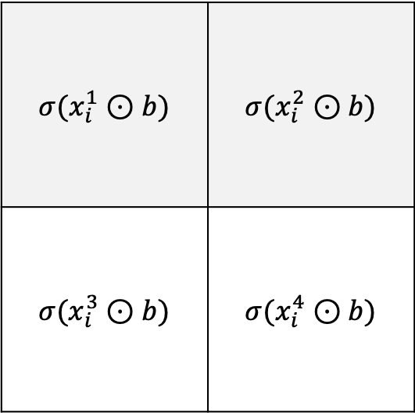
Examining filter output $σ(x_{i}^{R}⊙b)$, where $x_{i}^{R}$ is the portion of image $i$ where the filter is placed.
$$σ(x_{i}^{1}⊙b)$$ | $$σ(x_{i}^{2}⊙b)$$
$$σ(x_{i}^{3}⊙b)$$ | $$σ(x_{i}^{4}⊙b)$$
$$x_{i}^{1}$$
$$x_{i}^{2}$$
$$x_{i}^{3}$$
$$x_{i}^{4}$$

Slide 25
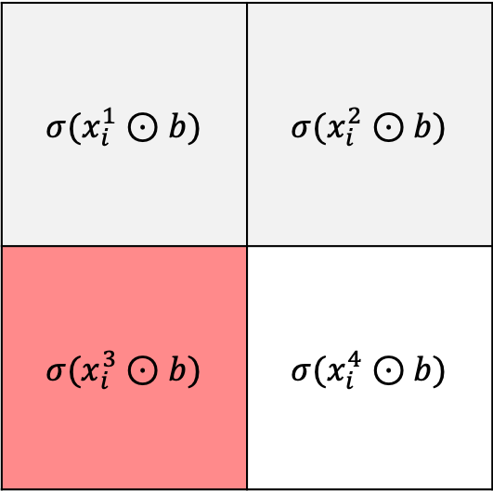
Examining filter output $σ(x_{i}^{R}⊙b)$, where $x_{i}^{R}$ is the portion of image $i$ where the filter is placed.
$$σ(x_{i}^{1}⊙b)$$ | $$σ(x_{i}^{2}⊙b)$$
$$σ(x_{i}^{3}⊙b)$$ | $$σ(x_{i}^{4}⊙b)$$
$$x_{i}^{1}$$
$$x_{i}^{2}$$
$$x_{i}^{3}$$
$$x_{i}^{4}$$

Slide 26
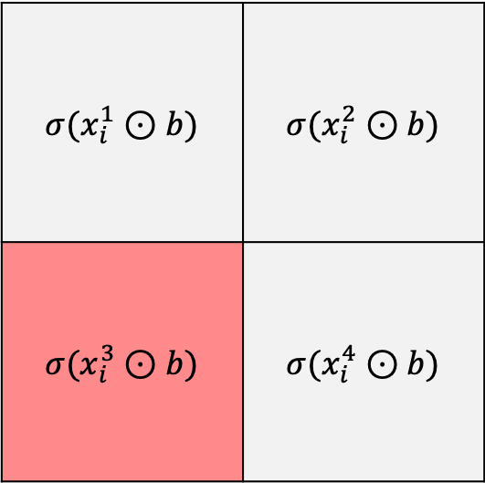
Examining filter output $σ(x_{i}^{R}⊙b)$, where $x_{i}^{R}$ is the portion of image $i$ where the filter is placed.
$$σ(x_{i}^{1}⊙b)$$ | $$σ(x_{i}^{2}⊙b)$$
$$σ(x_{i}^{3}⊙b)$$ | $$σ(x_{i}^{4}⊙b)$$
$$x_{i}^{1}$$
$$x_{i}^{2}$$
$$x_{i}^{3}$$
$$x_{i}^{4}$$

Slide 27
What if we want to know if a 1 is present anywhere in the image?
$$σ(x_{i}^{1}⊙b)$$ | $$σ(x_{i}^{2}⊙b)$$
$$σ(x_{i}^{3}⊙b)$$ | $$σ(x_{i}^{4}⊙b)$$
$$x_{i}^{1}$$
$$x_{i}^{2}$$
$$x_{i}^{3}$$
$$x_{i}^{4}$$

Slide 28
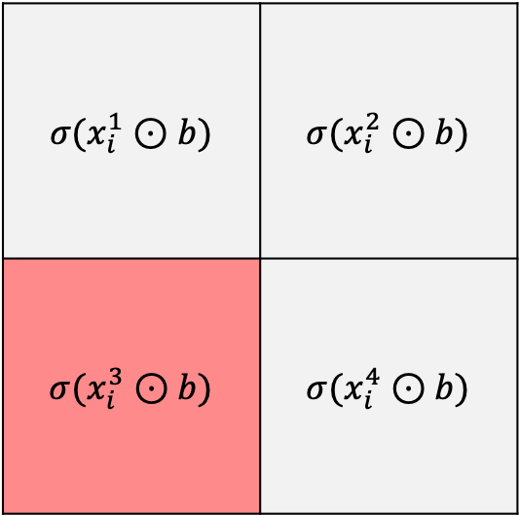
What if we want to know if a 1 is present anywhere in the image?
$$σ(x_{i}^{1}⊙b)$$ | $$σ(x_{i}^{2}⊙b)$$
$$σ(x_{i}^{3}⊙b)$$ | $$σ(x_{i}^{4}⊙b)$$
MAX

Slide 29
This idea is called “max pooling”, and is widely used in CNNs to determine whether features are present in a given region
$$σ(x_{i}^{1}⊙b)$$ | $$σ(x_{i}^{2}⊙b)$$
$$σ(x_{i}^{3}⊙b)$$ | $$σ(x_{i}^{4}⊙b)$$
MAX

Slide 30
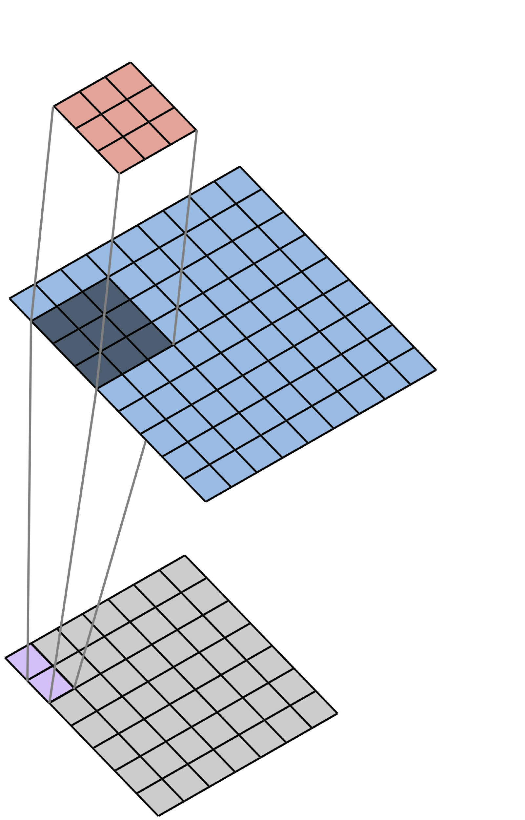
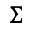

We perform “2D Spatial Convolution” as we move the filter across the image.
Filter
$$×$$
Image
$$Σ$$
Convolved Image
(Feature Map)

Slide 31
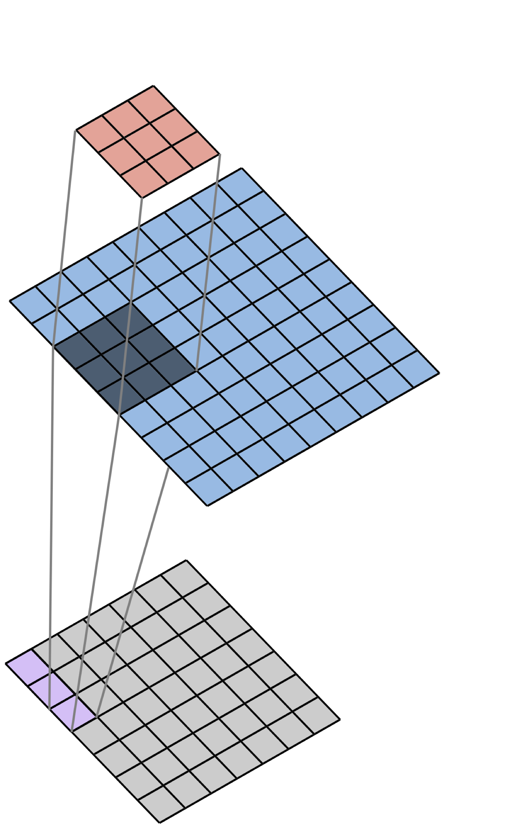
We perform “2D Spatial Convolution” as we move the filter across the image.
Filter
$$×$$
Image
$$Σ$$
Convolved Image
(Feature Map)

Slide 32
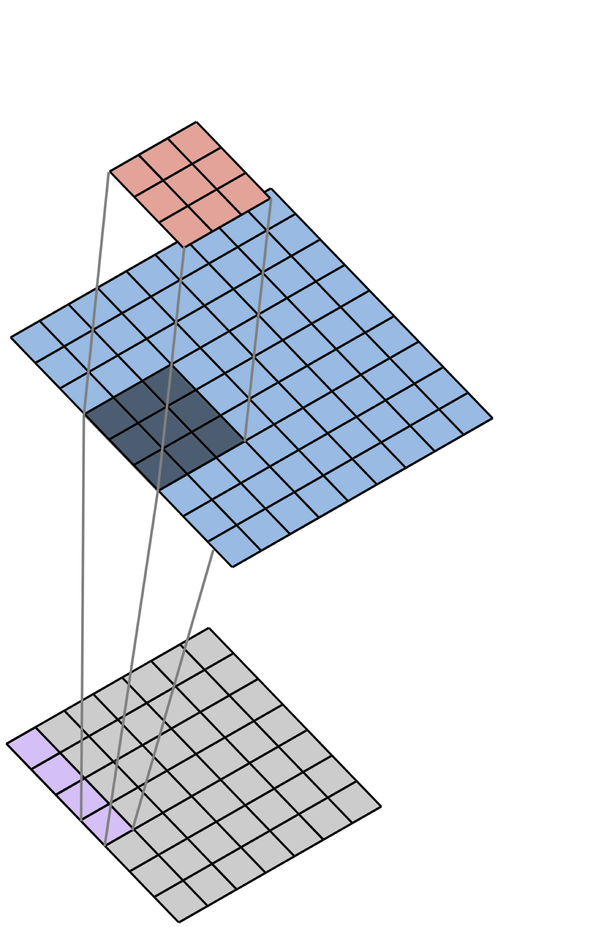
We perform “2D Spatial Convolution” as we move the filter across the image.
Filter
$$×$$
Image
$$Σ$$
Convolved Image
(Feature Map)

Slide 33
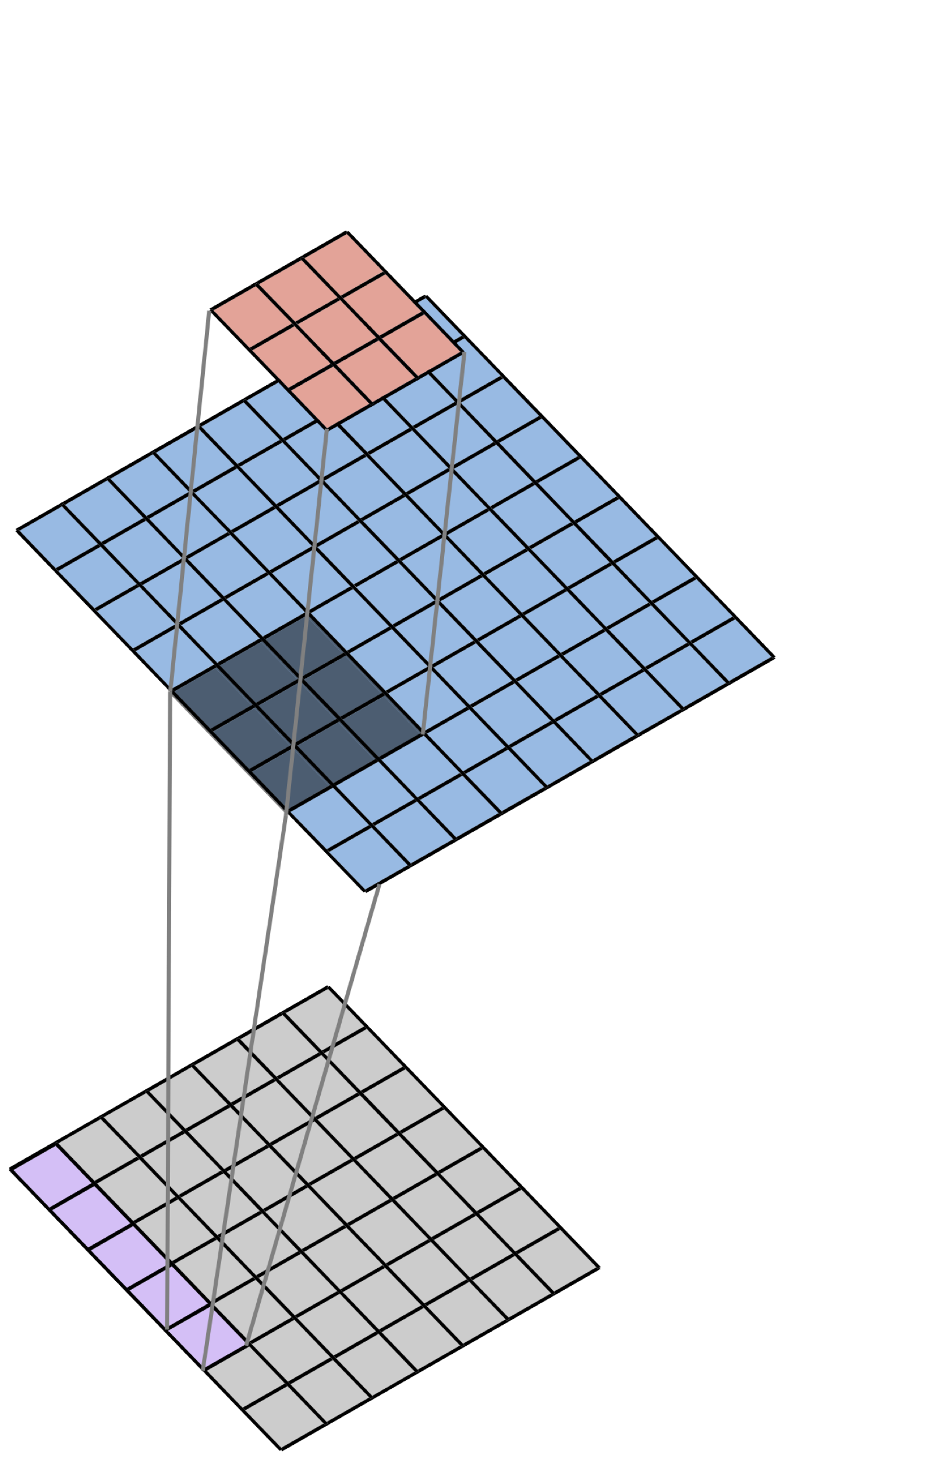
We perform “2D Spatial Convolution” as we move the filter across the image.
Filter
$$×$$
Image
$$Σ$$
Convolved Image
(Feature Map)

Slide 34
An Example…
filter
image

Slide 35
An Example…
-1 | -1 | -1 | -1 | -1
-1 | -1 | -1 | 1 | -1
-1 | -1 | 1 | -1 | 1
-1 | -1 | -1 | 1 | -1
-1 | -1 | -1 | -1 | -1
-1 | 1 | -1
1 | -1 | 1
-1 | 1 | -1
filter
image

Slide 36
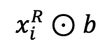
An Example…
-1
filter
image
$$x_{i}^{R}⊙b$$

Slide 37
An Example…
-1 | 5
filter
image
$$x_{i}^{R}⊙b$$

Slide 38
An Example…
-1 | 5 | -5
filter
image
$$x_{i}^{R}⊙b$$

Slide 39
An Example…
-1 | 5 | -5
3
filter
image
$$x_{i}^{R}⊙b$$

Slide 40
An Example…
-1 | 5 | -5
3 | -5
filter
image
$$x_{i}^{R}⊙b$$

Slide 41
An Example…
-1 | 5 | -5
3 | -5 | 9
filter
image
$$x_{i}^{R}⊙b$$

Slide 42
An Example…
-1 | 5 | -5
3 | -5 | 9
-1
filter
image
$$x_{i}^{R}⊙b$$

Slide 43
An Example…
-1 | 5 | -5
3 | -5 | 9
-1 | 5
filter
image
$$x_{i}^{R}⊙b$$

Slide 44
An Example…
-1 | 5 | -5
3 | -5 | 9
-1 | 5 | -5
filter
image
$$x_{i}^{R}⊙b$$

Slide 45
An Example…
-1 | 5 | -5
3 | -5 | 9
-1 | 5 | -5
filter
image
$$x_{i}^{R}⊙b$$

Slide 46
Each location where the filter was centered has been evaluated: “how similar is this location to the filter”?
-1 | 5 | -5
3 | -5 | 9
-1 | 5 | -5
filter
image
$$x_{i}^{R}⊙b$$

Slide 47
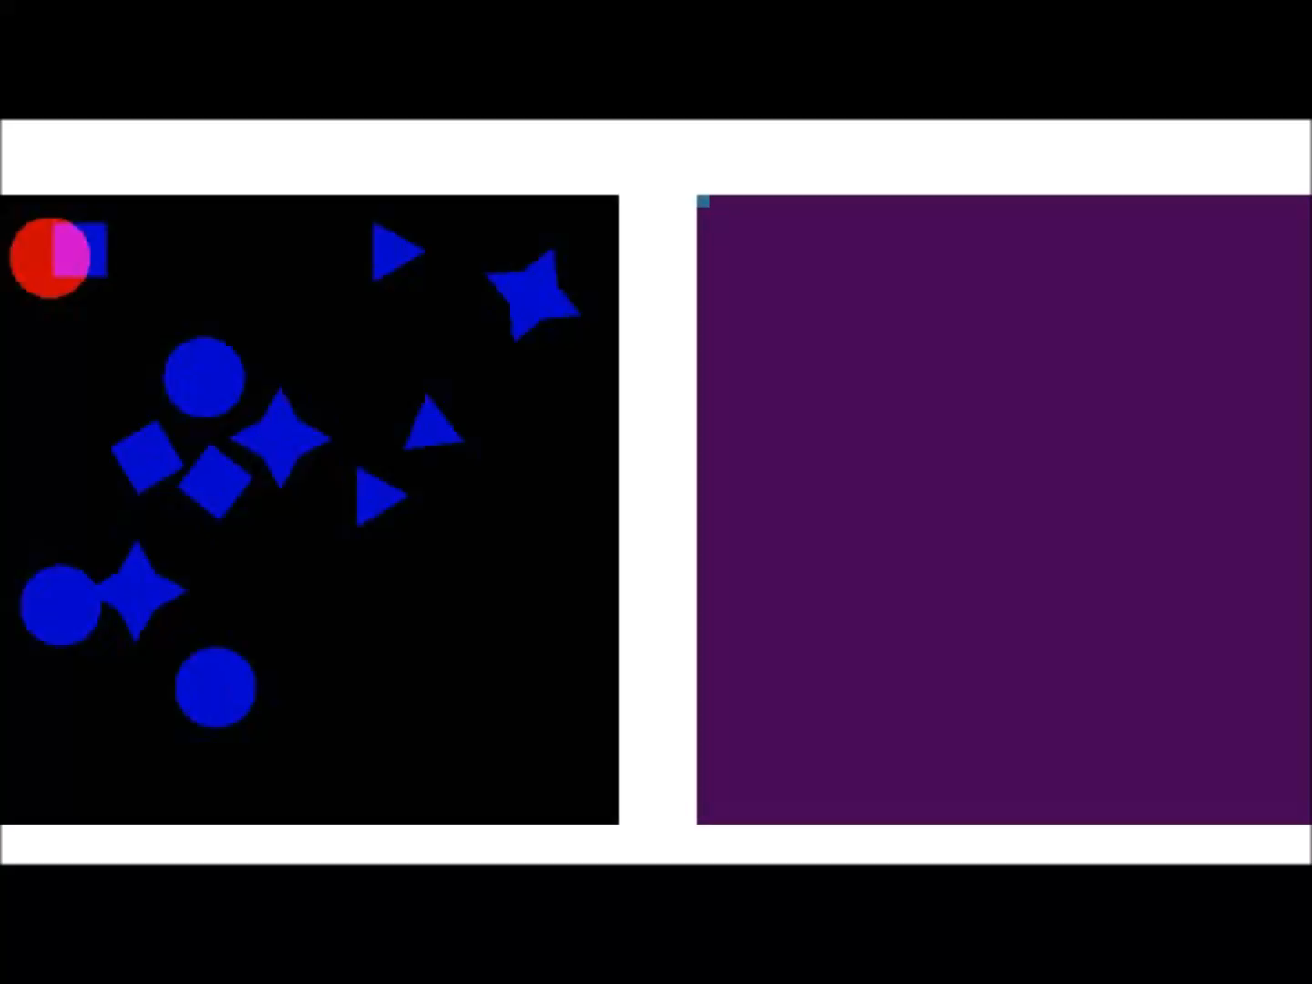
Convolutional Filters Are Feature Detectors

Slide 48
Now we know how to identify a “1” or a “0” anywhere in an image.
What if we want to identify a “10”?
Option 1: Design a new filter for “10”
Option 2: Utilize our “1” and “0” filters…

Slide 49
“1” filter output
“0” filter output

Slide 50
“1” filter output
“0” filter output
Our “10” filter looks for a match from the “1”
filter to the left of a match from the “0” filter

Slide 51
“1” filter output
“0” filter output
In this way, we learn to identify a hierarchy of features rather than a huge number of complex features
Notes:
BIG transition here…
Digits to numbers
Letters to words
Really – visual motifs at varying levels of complexity

Slide 52
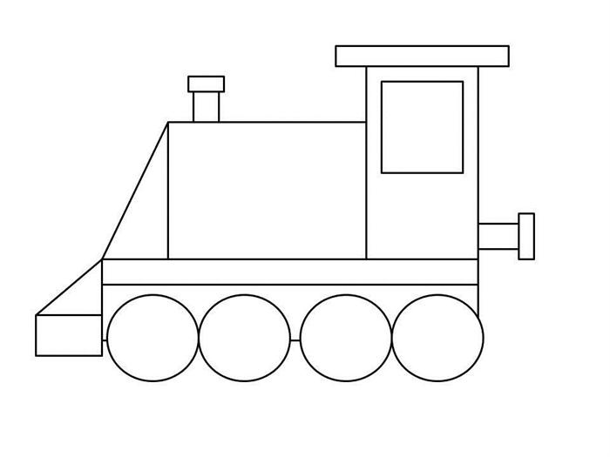
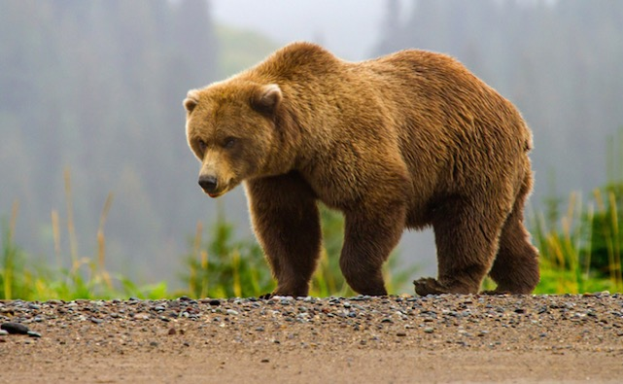
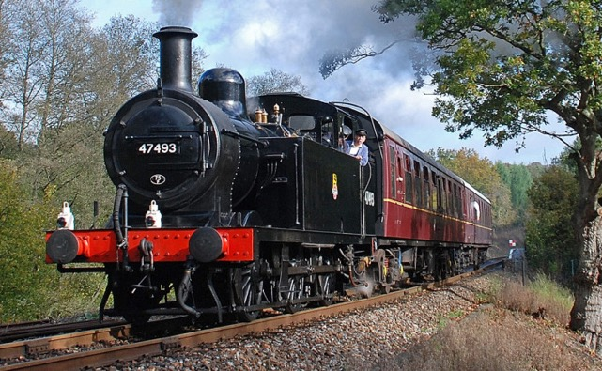
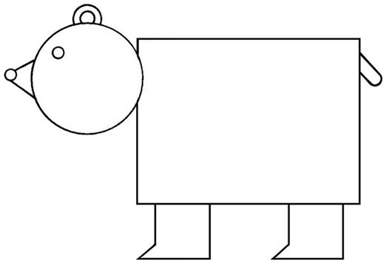
CNNs Take Advantage of Repeated, Hierarchical Structure in Images
Notes:
Show real bear & train

Slide 53
CNNs Take Advantage of Repeated, Hierarchical Structure in Images
Notes:
Show real bear & train

Slide 54
CNNs Take Advantage of Repeated, Hierarchical Structure in Images
Low-level structure: lines, curves
Notes:
Show real bear & train

Slide 55
CNNs Take Advantage of Repeated, Hierarchical Structure in Images
Low-level structure: lines, curves

Slide 56
CNNs Take Advantage of Repeated, Hierarchical Structure in Images
Mid-level structure: shapes

Slide 57
CNNs Take Advantage of Repeated, Hierarchical Structure in Images
Mid-level structure: shapes

Slide 58
CNNs Take Advantage of Repeated, Hierarchical Structure in Images
High-level structure: groups of shapes
Notes:
Add bounding boxes here

Slide 59
CNNs Take Advantage of Repeated, Hierarchical Structure in Images
Bear
Train
High-level structure: groups of shapes → objects
Notes:
Point out similarities in groups of shapes

Slide 60

Consider a Set of “Toy” Images,
for illustration of how this structure can be extracted by an algorithm
Notes:
Constructed motifs.
Where the motifs at different levels are deliberate and clear.
This will allow us to think about filters that identify motifs at different levels, and how filters at different levels work together.

Slide 61
High-Level Motifs/Structure
Notes:
Note that these motifs can occur in different parts of the images

Slide 62
Shared Substructure Within Motifs
Notes:
Color code individual elements rather than having boxes. Cut down on the number of submotifs

Slide 63
Shared Substructure Within Motifs

Slide 64
Shared Substructure Within Motifs

Slide 65
Shared Substructure Within Motifs

Slide 66
Hierarchical Representation of Images
Layer 3:
Motifs
Layer 2:
Sub-Motifs
Layer 1:
Fundamental Building Blocks
Notes:
Spend time here explaining that we’ve established 3 levels. That if we had a system that could extract features of each level in sequence, we could build up a hierarchical feature map.

Slide 67
Recall the Data/Images
Notes:
Remove noise?

Slide 68
Convolutional Filter
Notes:
Add the image as a watermark, and make the heatmap light up w/o circles – add grid and have it light up.
Really belabor point that this creates feature heatmaps

Slide 69
Convolutional Filter
Notes:
Add the image as a watermark, and make the heatmap light up w/o circles – add grid and have it light up.
Really belabor point that this creates feature heatmaps

Slide 70
Convolutional Filter
Notes:
We’ll call these outputs “feature maps”, because they tell us about the locations of a specific feature.

Slide 71
Multiple Filters, One for Each Building Block
Input Image
Filters

Slide 72
Feature “Maps”
Input Image
Filters

Slide 73
Feature “Maps”
Layer-2 Filters
Input Image
Filters
Notes:
Color code the filters in this slide already

Slide 74
Feature “Maps”
Layer-2 Filters
Input Image
Filters

Slide 75
Layer 1
Feature “Maps”
Layer-2 Filters
Input Image
Layer-1 Filters

Slide 76
Layer 2
Feature “Maps”
Layer 1
Feature “Maps”
Layer-2 Filters
Input Image
Layer-1 Filters

Slide 77
Layer 2
Feature “Maps”
Layer-3 Filters
Layer 1
Feature “Maps”
Layer-2 Filters
Input Image
Layer-1 Filters

Slide 78
Layer 3
Feature “Maps”
Layer 2
Feature “Maps”
Layer-3 Filters
Layer 1
Feature “Maps”
Layer-2 Filters
Input Image
Layer-1 Filters

Slide 79
Deep CNN Architecture
Layer 3
Feature “Maps”
Classifier
Layer 2
Feature “Maps”
Layer-3 Filters
Layer 1
Feature “Maps”
Layer-2 Filters
Input Image
Layer-1 Filters
Notes:
High-level layer-3 feature maps: look for presence of hemorrhagic spots.

Slide 80
Advantage of Hierarchical Features?
By learning and sharing statistical similarities
within high-level motifs, we better leverage
all training data
If we do not use such a hierarchy, top-level
motifs would be learned in isolation of
each other
Layer 3:
Layer 2:
Layer 1
Notes:
Need to change words here

Slide 81
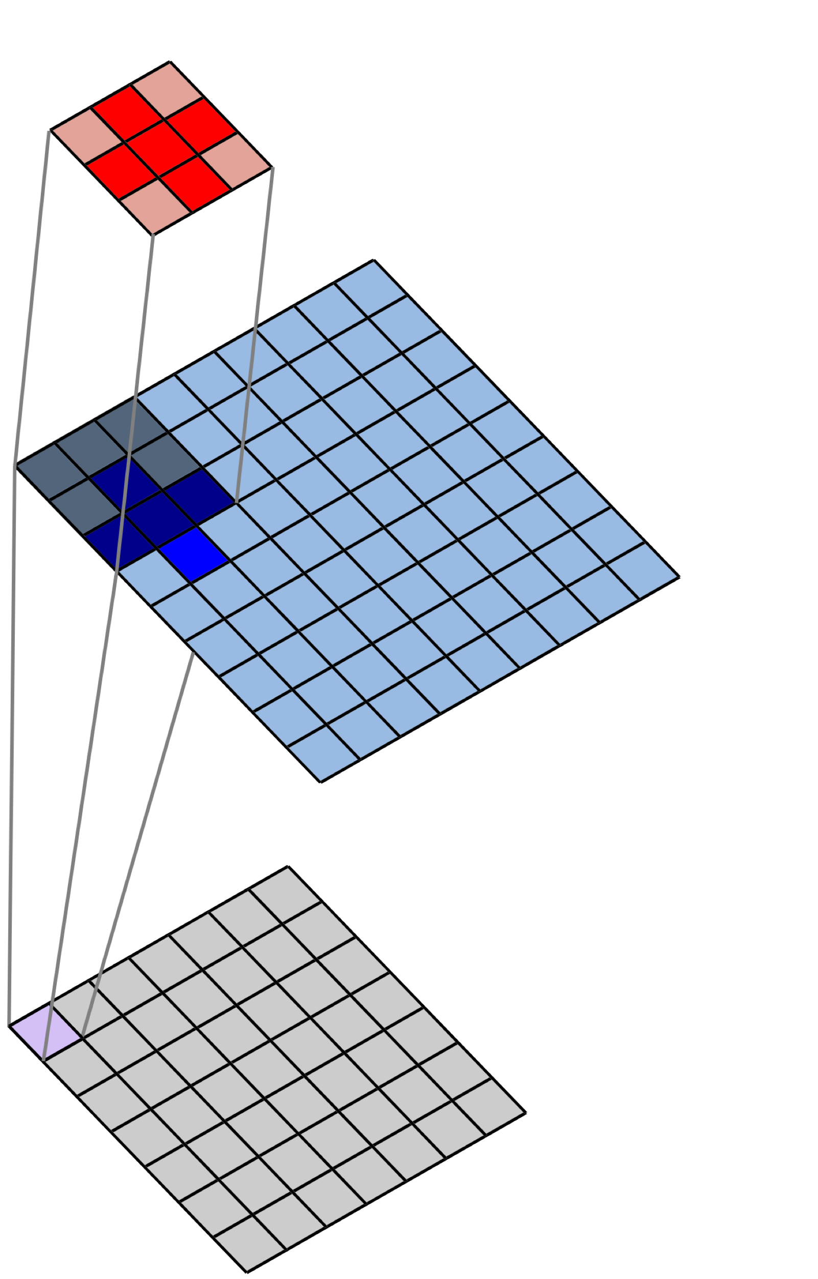
2D Spatial Convolution
Filter
$$×$$
Image
$$Σ$$
Convolved Image
(Feature Map)
Notes:
We’re going back to this, because we will point out that filters actually operate over volumes

Slide 82
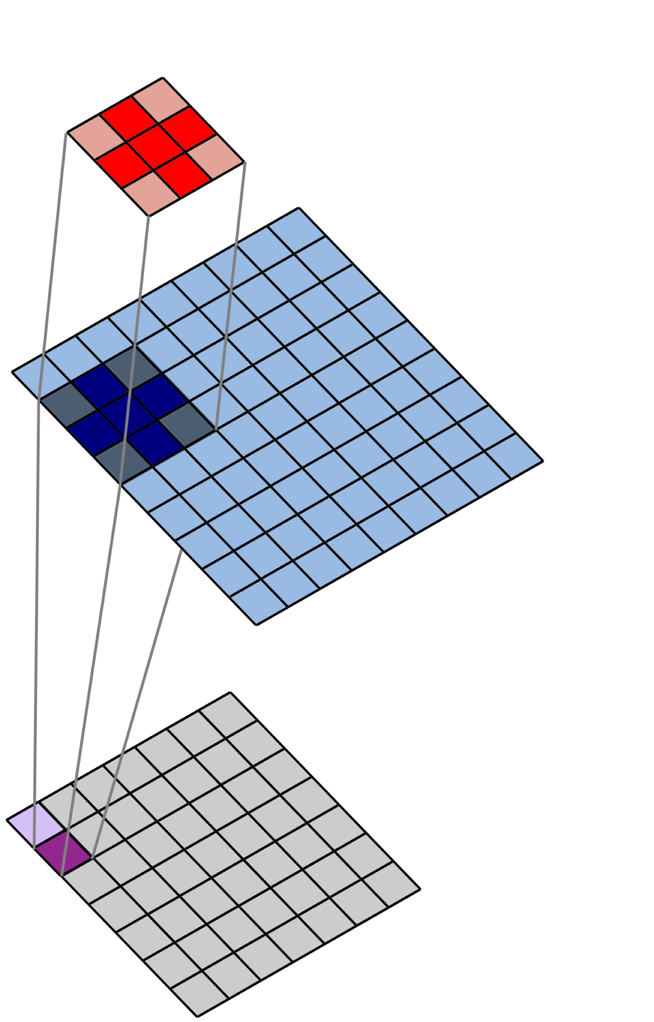
2D Spatial Convolution
Filter
$$×$$
Image
$$Σ$$
Convolved Image
(Feature Map)

Slide 83
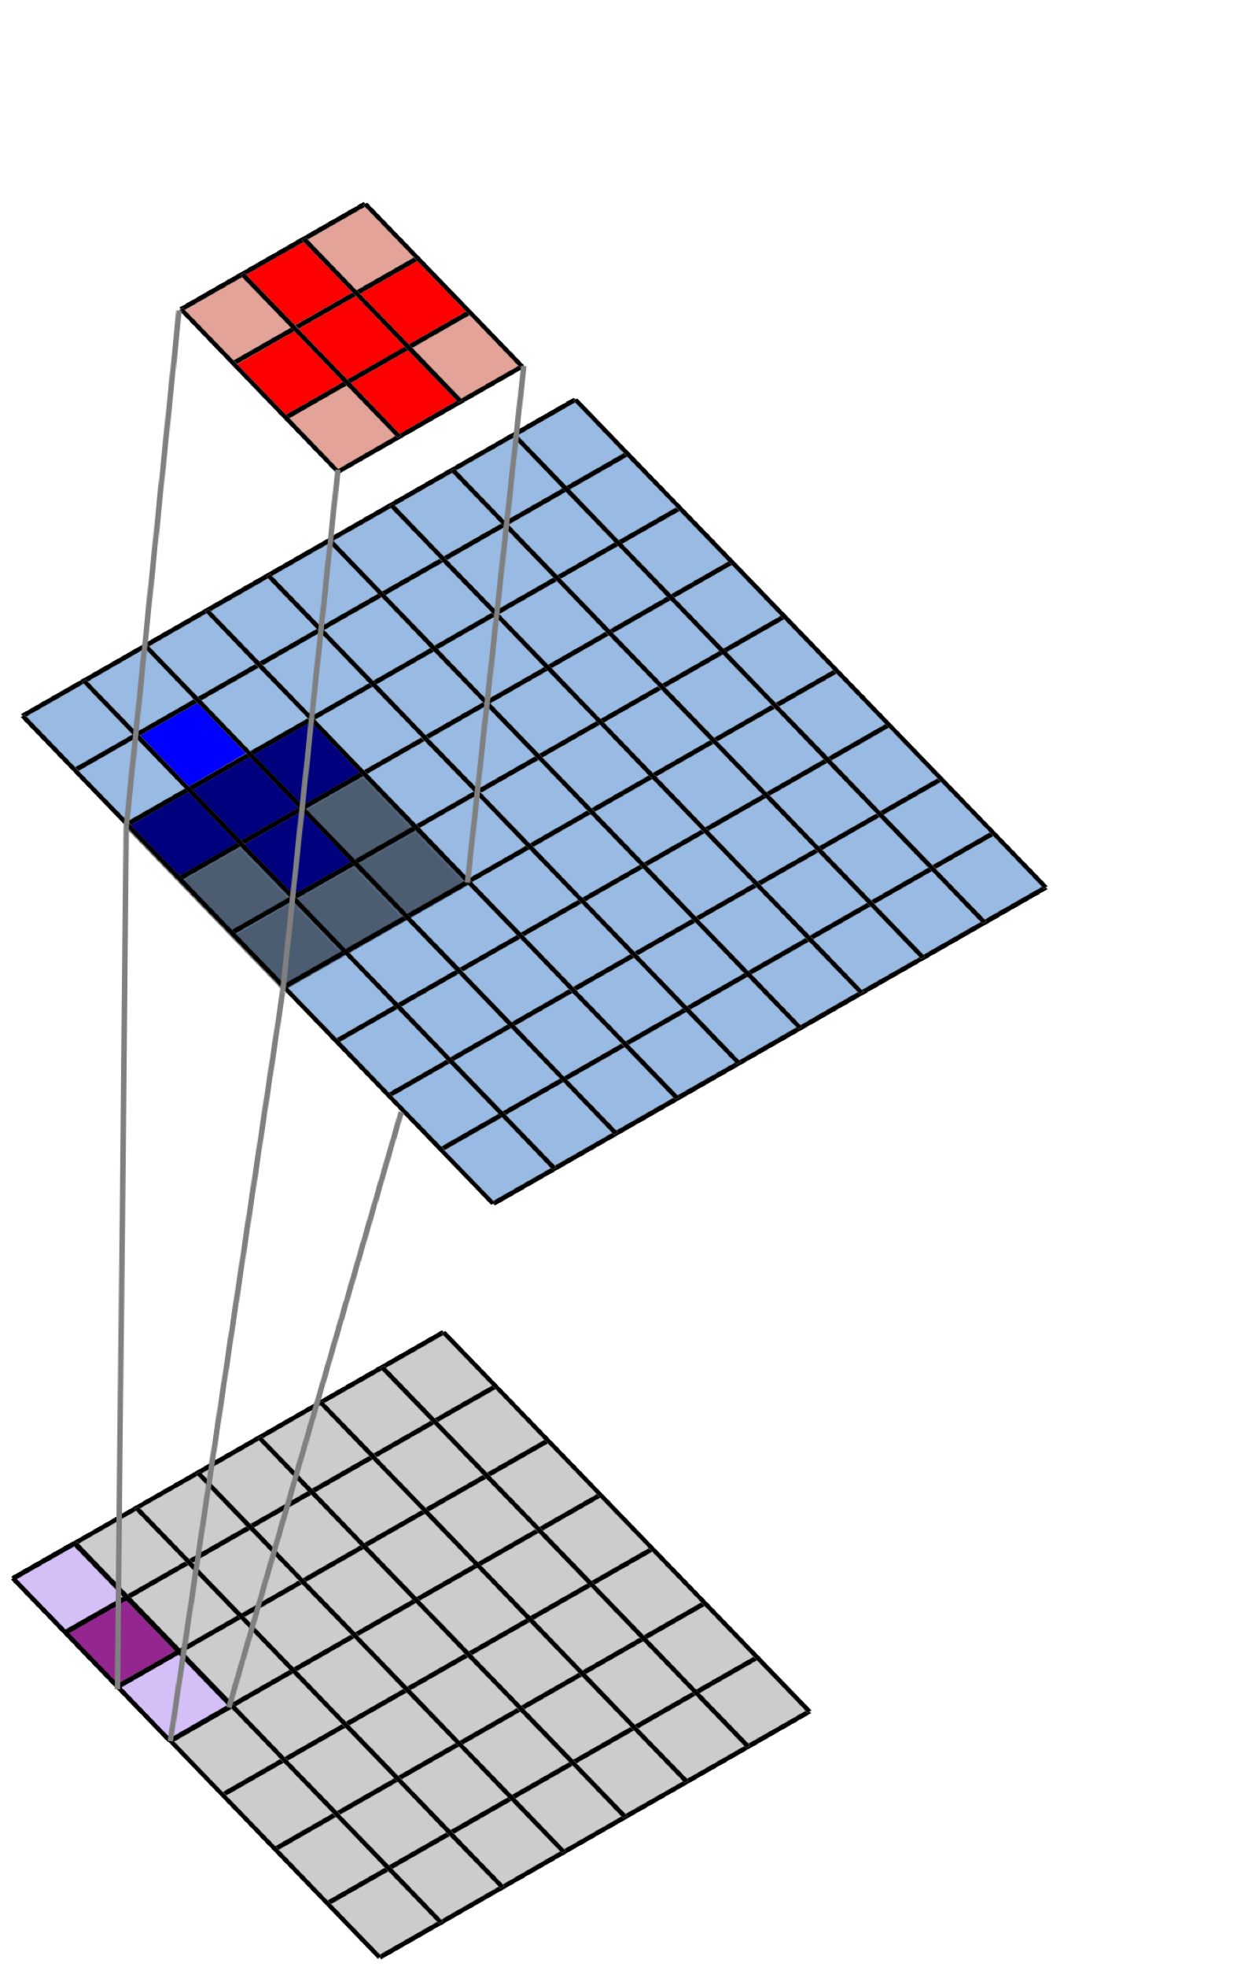
2D Spatial Convolution
Filter
$$×$$
Image
$$Σ$$
Convolved Image
(Feature Map)

Slide 84
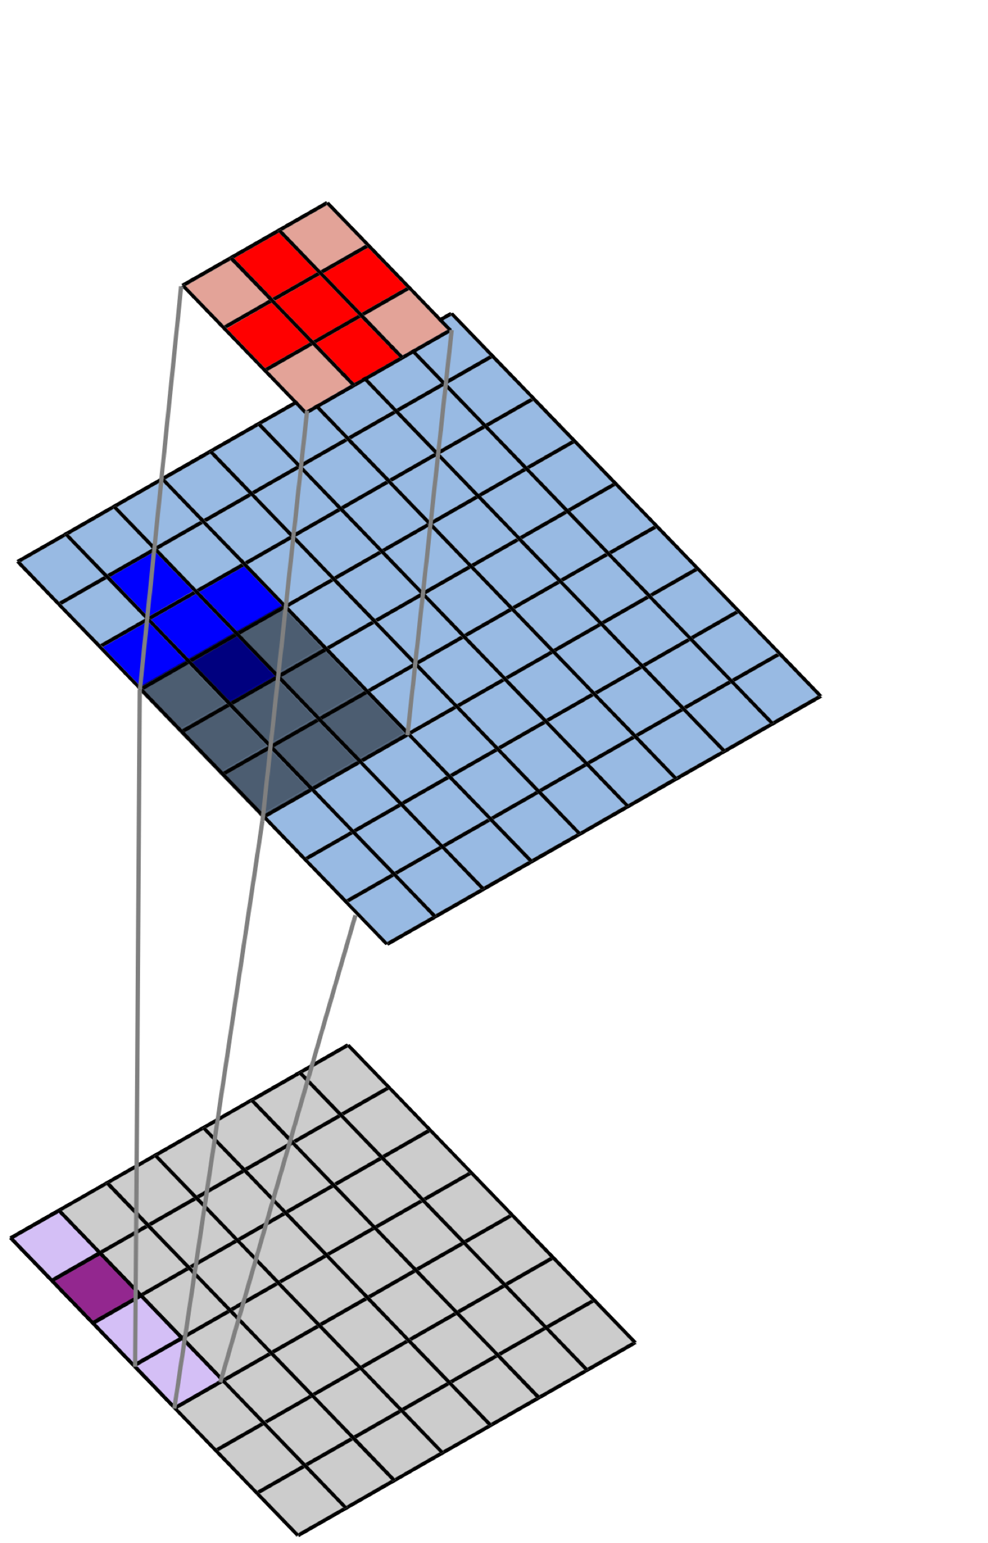
2D Spatial Convolution
Filter
$$×$$
Image
$$Σ$$
Convolved Image
(Feature Map)

Slide 85
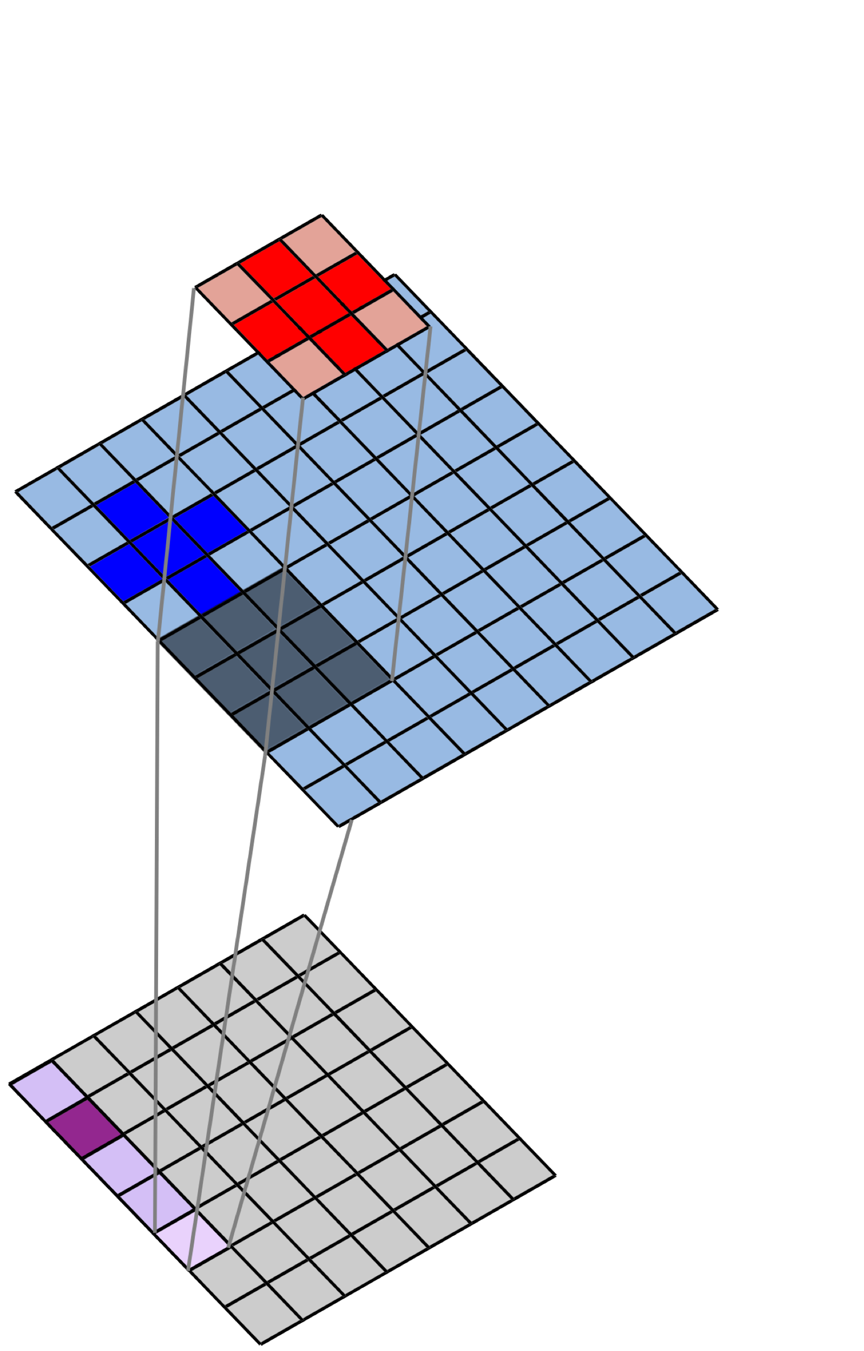
2D Spatial Convolution
Filter
$$×$$
Image
$$Σ$$
Convolved Image
(Feature Map)

Slide 86
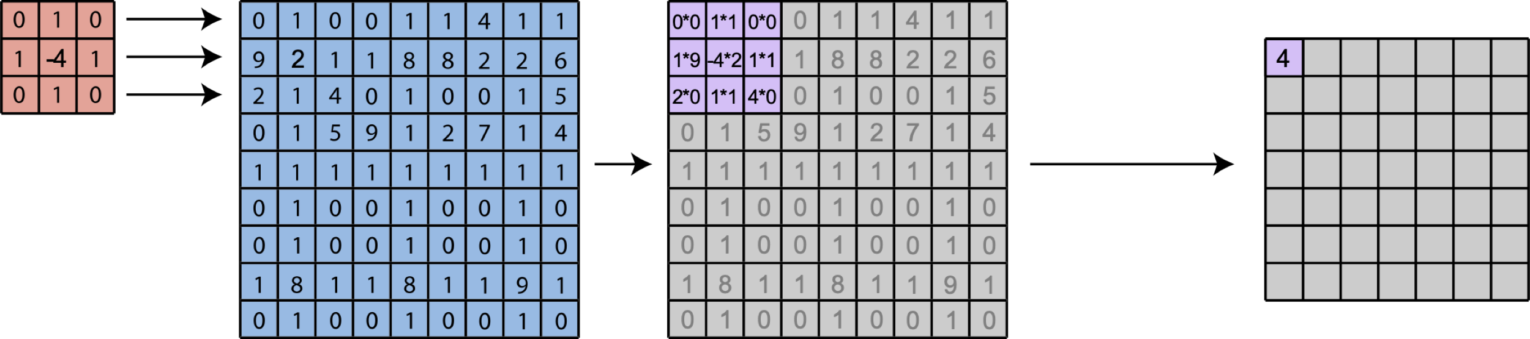
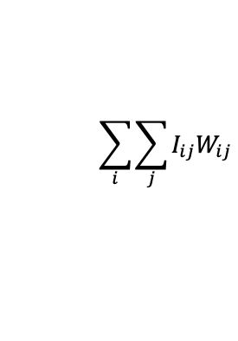
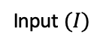
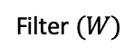
2D Spatial Convolution
Filter $(W)$
Input $(I)$
$$\sum_{i}{\sum_{j}{I_{ij}W_{ij}}}$$
Notes:
Apply this filter to a real image and show output

Slide 87
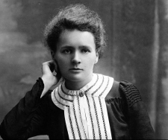
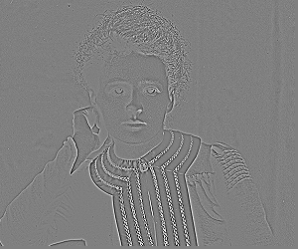
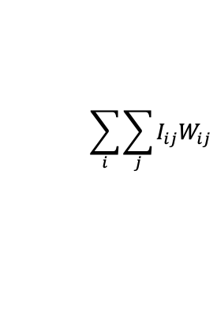
2D Spatial Convolution
Filter $(W)$
Input $(I)$
$$\sum_{i}{\sum_{j}{I_{ij}W_{ij}}}$$
Notes:
Apply this filter to a real image and show output. Maybe explain why this works to add time

Slide 88
Filters Operate Over Input Volumes
Feature “Maps”
Layer-2 Filters
Input Image
Filters

Slide 89
Filters Operate Over Input Volumes
Feature “Maps”
Layer-2 Filters
Input Image
Filters

Slide 90
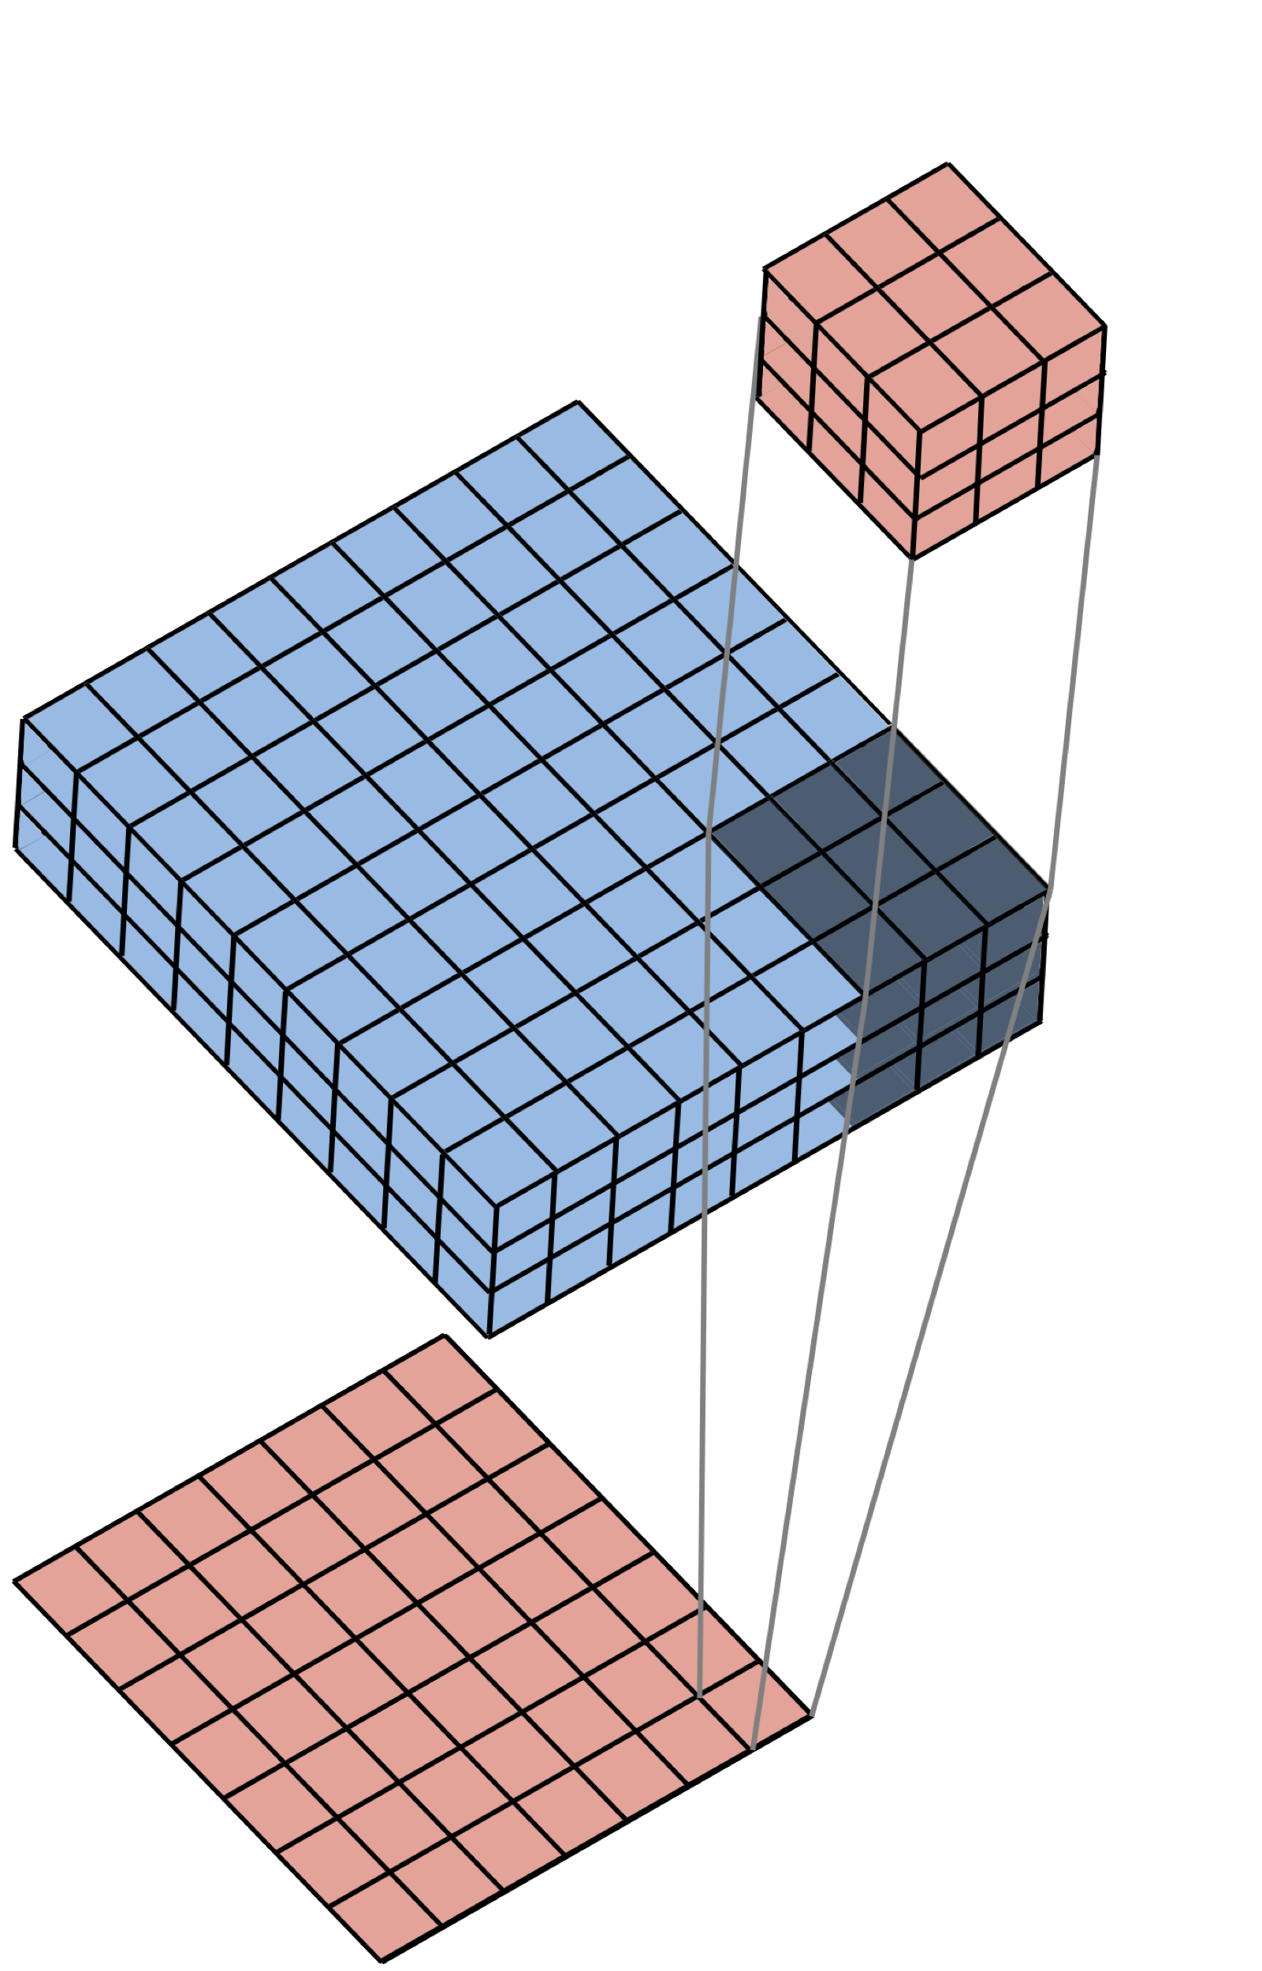
Filters Operate Over Input Volumes
Filter (3x3x3)
Image (9x9x3)
Feature Map (7x7x1)
Notes:
Mention that we’re going to show an example of this in the next slide

Slide 91
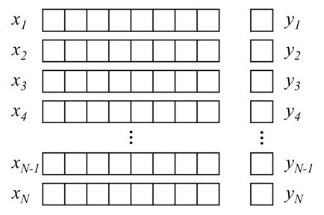
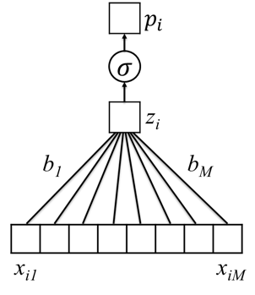
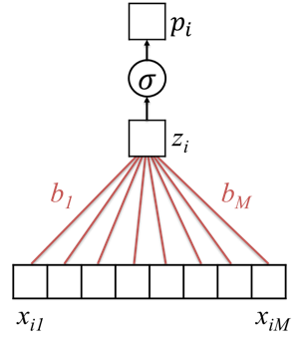
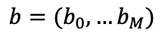
Given Labeled Training Images, How do we Learn the Parameters of the CNN?
Training Set
$$p_{i}=σ(b_{0}+b_{1}x_{i1}+b_{2}x_{i2}+…+b_{M}x_{iM})$$
$b=(b_{0},…b_{M})$
Untrained Logistic Regression
Model (or “Network”)
Trained Model (with learned parameters)

Slide 92
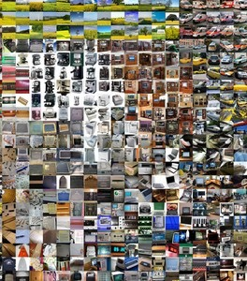
Given Labeled Training Images, How do we Learn the Parameters of the CNN?
CNN
Architecture
Trained
CNN

Slide 93
Architecture (specified) vs Parameters (learned)
Architecture:
Number of layers
Layer types (e.g. convolutional, pooling, fully connected)
Number of filters in each layer
Shape and size of filters
Use 3x3 filters
In layer 1
Parameters:
Individual Elements of each filter
Parameters of other layers
Learn values of
Each layer 1 filter
-1 | 1 | -1
1 | -1 | 1
-1 | 1 | -1

Slide 94
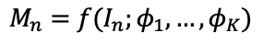
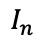
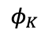


Feature “Maps”
$$M_{n}=f(I_{n};φ_{1},…,φ_{K})$$
$$φ_{1}$$
$$φ_{2 ……}$$
$$φ_{K}$$
Input Image
Layer-1 Filters
$$I_{n}$$
Notes:
Remember, we’re working our way toward the loss.
Emphasize here that these are individual filters ultimately contributing to a loss

Slide 95









Layer 2 Feature “Maps”
$$L_{n}=f(M_{n};ψ_{1},…,ψ_{K})$$
$$ψ_{1}$$
$$ψ_{2 ……}$$
$$ψ_{K}$$
Layer-2 Filters
Layer 1 Feature “Maps”
$$M_{n}=f(I_{n};φ_{1},…,φ_{K})$$
$$φ_{1}$$
$$φ_{2 ……}$$
$$φ_{K}$$
Input Image
Layer-1 Filters
$$I_{n}$$

Slide 96













Layer 3 Feature “Maps”
$$G_{n}=f(L_{n};ω_{1},…,ω_{K})$$
$$ω_{1}$$
$$ω_{2 ……}$$
$$ω_{K}$$
Layer-3 Filters
Layer 2 Feature “Maps”
$$L_{n}=f(M_{n};ψ_{1},…,ψ_{K})$$
$$ψ_{1}$$
$ψ_{2 ……}$
$$ψ_{K}$$
Layer-2 Filters
Layer 1 Feature “Maps”
$$M_{n}=f(I_{n};φ_{1},…,φ_{K})$$
$$φ_{1}$$
$${ φ}_{2 ……}$$
$$φ_{K}$$
Input Image
Layer-1 Filters
$$I_{n}$$

Slide 97














Layer 3 Feature “Maps”
$$G_{n}=f(L_{n};ω_{1},…,ω_{K})$$
$$ℓ(G_{n};W)$$
$$ω_{1}$$
$$ω_{2 ……}$$
$$ω_{K}$$
Layer-3 Filters
Layer 2 Feature “Maps”
$$L_{n}=f(M_{n};ψ_{1},…,ψ_{K})$$
$$ψ_{1}$$
$ψ_{2 ……}$
$$ψ_{K}$$
Layer-2 Filters
Layer 1 Feature “Maps”
$$M_{n}=f(I_{n};φ_{1},…,φ_{K})$$
$$φ_{1}$$
$${ φ}_{2 ……}$$
$$φ_{K}$$
Input Image
Layer-1 Filters
$$I_{n}$$

Slide 98















$$G_{n}=f(L_{n};ω_{1},…,ω_{K})$$
Layer 3
Feature “Maps”
$$ℓ\left(G_{n};W\right)=ℓ_{n}$$
$$ω_{1}$$
$${ ω}_{2 ……}$$
$$ω_{K}$$
Assume we have labeled images ${\left\{I_{n},y_{n}\right\}}_{n=1,N}$
$I_{n}$ is image n, $y_{n}∈\{+1,−1\}$ is associated label
Average loss, which depends on model parameters:
Find specific parameters that minimize the average loss
Layer-3 Filters
Layer 2
Feature “Maps”
$$L_{n}=f(M_{n};ψ_{1},…,ψ_{K})$$
$$ψ_{1}$$
$ψ_{2 ……}$
$$ψ_{K}$$
$$1/N\sum_{n=1}^{N}{loss(y_{n},ℓ_{n})}$$
Layer-2 Filters
Layer 1
Feature “Maps”
$$M_{n}=f(I_{n};φ_{1},…,φ_{K})$$
$$φ_{1}$$
$${ φ}_{2 ……}$$
$$φ_{K}$$
Input Image
Layer-1 Filters
$$I_{n}$$

Slide 99
Summary
Convolutional neural networks learn to recognize high-level structure in images by building hierarchical representations of features
Features are extracted via spatial convolutions with filters
Filters are learned via iterative minimization of a loss function
Convolutional neural networks have shown capabilities beyond human performance for image analysis

